Slide 1

AZURA
ITM University • B.Tech CSE III Sem
AZURA Global Tourism
A high-performance MySQL relational schema connecting worldwide destinations, dynamic packages, booking lifecycles, and transactions.
PROJECT TEAM
FACULTY MENTOR
Kush Tayal (BETN1CS25028) • Krishna Yadav (BETN1CS25044) • Aniket Yadav (BETN1CS25011)
Dr. Geetanjali Surange

Slide 2



The Core Tourism Data Challenge
01 • CONTEXT
Eliminating booking state fragmentation with single-source relational integrity
Scattered Records
Data Integrity Risks
Reporting Latency
Disjointed destination catalogs and hotel inventories lead to out-of-sync booking calendars.
Dangling references, duplicate customer accounts, and invalid negative sums corrupt reporting.
Management dashboards lack unified transactional views for live occupancy and revenue tracking.

Slide 3
System Scope & Architecture
02 • OVERVIEW
A modular three-tier database tier engineered for production travel operations
Tourism Domain Data
Database Logic
Operations & Security
Users: Profiles, roles, auth credentials
Constraints: PK, FK, CHECK and UNIQUE rules
Access: Strict role-based permissions (RBAC)
Catalog: Destinations, hotels, packages
Programmability: 5 procedures & 4 triggers
Auditing: Automated logs of booking transitions
Commerce: Bookings, payments, ratings
Indexing: B-Tree access paths on FK columns
DR Drill: Tested backup and schema restoration

Slide 4

Conceptual Data Model
03 • DATA DESIGN
All 8 core business entities mapped with strict relational cardinalities
ACTOR
CORE HUB
LODGING
CATALOG
USER
DESTINATION
HOTEL
PACKAGE
Makes Bookings • Writes Reviews
Contains Hotels • Offers Packages
Located in Destination • Stars/Amenities
Curated Itineraries • Includes Activities
Full Chen ER Model
All 8 domain entities normalized to 3NF. Connects destinations, lodging, booking lifecycles, payments, user reviews, and adventure experiences.
ACTIVITIES
TRANSACTION
LEDGER
FEEDBACK
EXPERIENCE
BOOKING
PAYMENT
REVIEW
Destination Adventures & Excursions
Connects User & Package • Status
Linked to Booking • Method & Amount
User Reviews Destination • 1 to 5 Stars
Core Entities: 8
Bridge Tables: 2

Slide 5
Relational Design & Integrity Controls
04 • INTEGRITY
Defending the database boundary with native schema-level rules
Referential Integrity
Validation Checks
Normalization (3NF)
Strict cascading and foreign key parent checks.
Preventing invalid boundary data at SQL execution.
Eliminated transitive and partial dependencies.
booking.user_id → user.id
payment.booking_id → booking.id
CHECK (num_travelers > 0)
CHECK (rating BETWEEN 1 AND 5)
Composite key: (hotel_id, room_no)
Decoupled hotel amenities bridge

Slide 6
Implemented Database Objects
05 • MYSQL ENGINE
Complete inventory of physical objects built and tested on MySQL 8.0
16
6
9
4
Base Tables
Materialized Views
Routines & Funcs
Active Triggers
Core, Bridge & Audit Logs
Analytics & Travel Catalogs
5 Procedures + 4 Functions
Audit & State Automation
Migration Lifecycle:
Versions 1.0 → 1.4 tracked via schema_migrations
ENGINE: INNODB • MYSQL 8.0

Slide 7
Data Volume & Seeding Benchmarks
06 • DATA BENCHMARKS
Stress-tested dataset covering all 8 entities to validate query plans and indexing
100
1,007
1,007
Destinations
Bookings
Payments
Global catalog coverage
Transaction records
1:1 ledger reconciliation
104
100
2
PORTFOLIO VERIFIED
20 Complex Analytics Queries
Hotels / Packages
Experiences
Reviews
CTEs, window ranking (DENSE_RANK), multi-table joins, date aggregation, and conditional CASE analytics verified on MySQL 8.0.
Lodging & itineraries
Excursions & activities
CHECK (1-5) tested

Slide 8
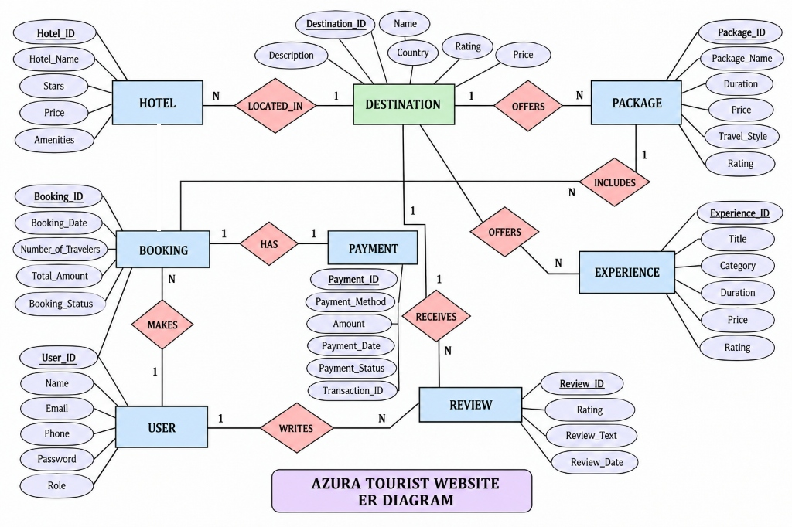

Slide 9



Database Security & Audit Trail
07 • SECURITY
Enforcing least-privilege, parameterized SQL, and mutation tracking
Least Privilege (RBAC)
Injection Defense
Rollback & Audit
Admin vs customer roles. Customer DELETE privileges on catalog tables are rejected by MySQL engine.
Prepared statements with strict typing. Injection test payloads (' OR 1=1) returned safe empty sets.
ACID transaction ROLLBACK restored modified booking statuses. Triggers recorded full audit entries.
VERIFIED: Access Denied
VERIFIED: Neutralized
VERIFIED: Audit Captured

Slide 10
Performance & Disaster Recovery
08 • READINESS
Query optimization with EXPLAIN and automated mysqldump restore drills
INDEX BENCHMARKS
65% ↓
Backup & Restoration Drill
Latency Reduction via Indexes
Verified physical disaster recovery by dumping and re-populating test environments.
Query execution dropped from 48.2 ms to 16.9 ms on user booking lookups via idx_bookings_user.
Dump Archive Size
394,073 bytes
Target Schema
azura_restore_test
EXPLAIN Result: Type ref • Key: idx_bookings_user
Integrity Status
100% Schema Rehydrated

Slide 11
Future Production Roadmap
09 • ROADMAP
Planned database architectural scaling for enterprise travel workloads
1
Cloud Replication & HA
2
Room Inventory Concurrency
Multi-region MySQL clustering and read-replicas for low latency and automatic failover.
Optimistic concurrency control and row locking to completely prevent double-booking.
3
Automated CI/CD Delivery
4
AI Search & Vector Embeddings
Automated migration pipeline using Liquibase/Flyway with test validation before deployment.
Integrate ARIA assistant with vector search for intent-driven travel package discovery.

Slide 12


AZURA RELATIONAL ARCHITECTURE
A Structured Database for a Connected Travel Experience
Thank you for your time. We are now ready for questions and live system evaluation.
Team NEXUS: Kush Tayal • Krishna Yadav • Aniket Yadav
ITM University • CSE Department

